Slide 1

Master Thesis Defence
Addressing Data Scarcity with 2D Projection-based 3D Point Cloud Semantic Segmentation
March 13, 2025
Presenter: Xi Luo, MASc student
Supervisor: Jong Won Ma
Committee Members
Dr. Sanghyeok Han
Dr. Po-Han Chen

Slide 2
Table of contents
01
02
03
04
05
06
Introduction
Literature Review
Objectives
Background about the topic
Related study
Motivation of this study
Methodology
Conclusions
Pipeline of
Experiments & Results
Discussion and conclusions
Experimental design and results

Slide 3

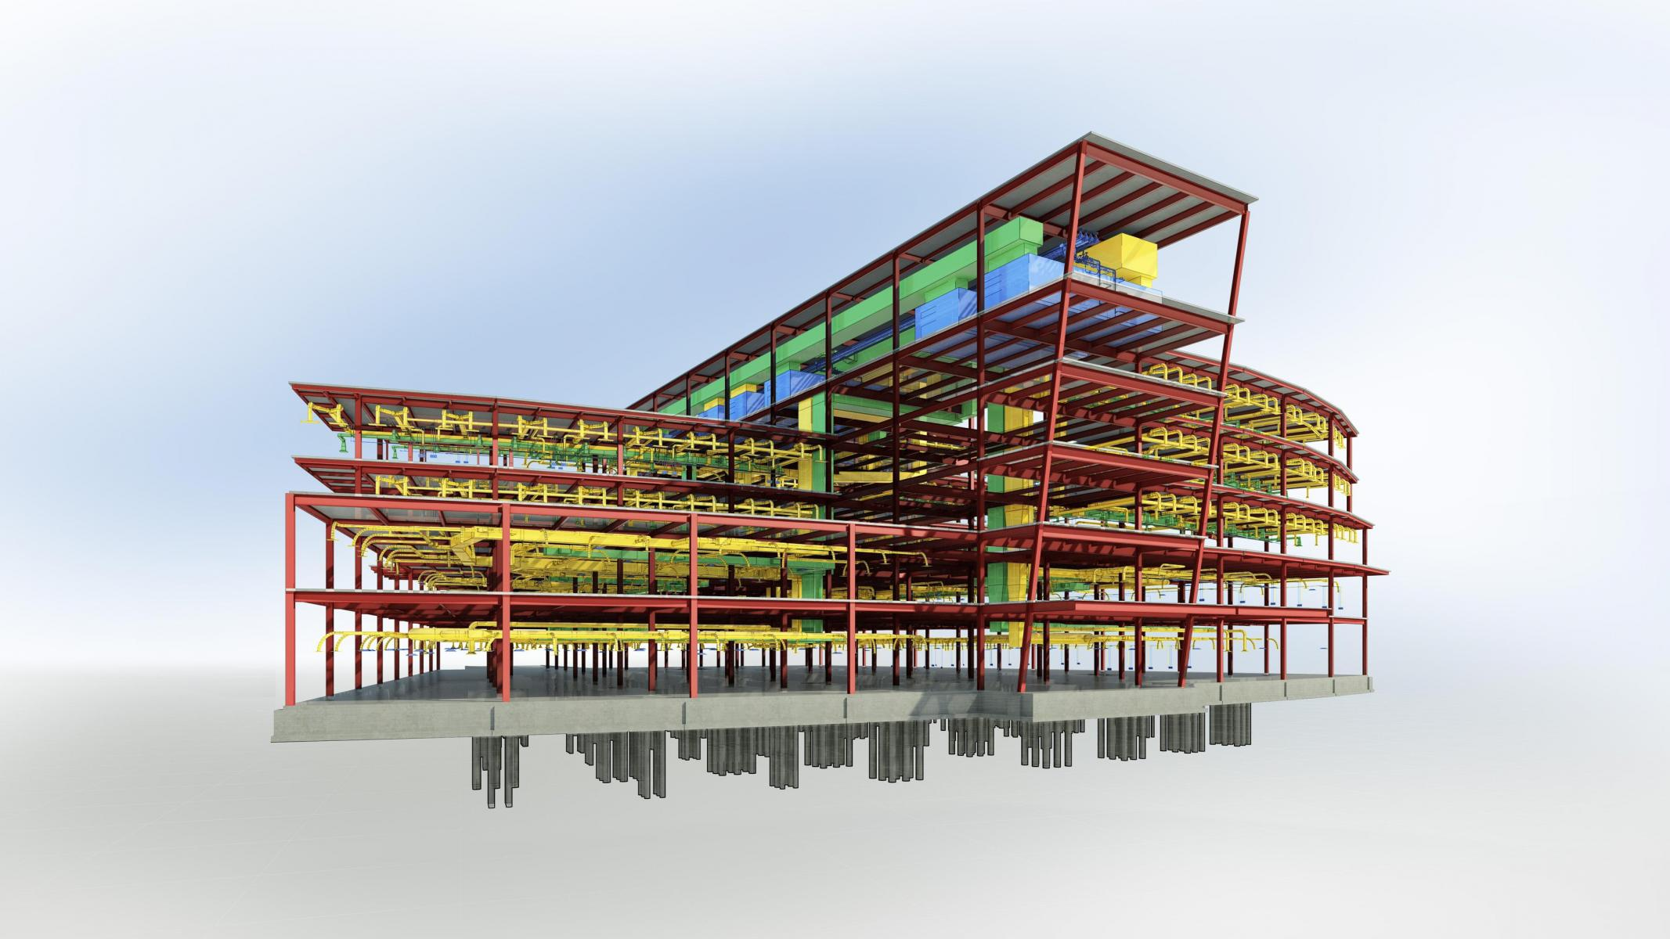
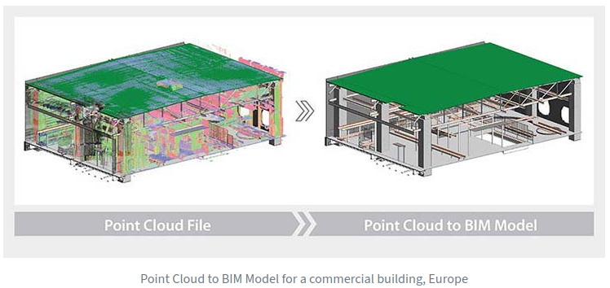

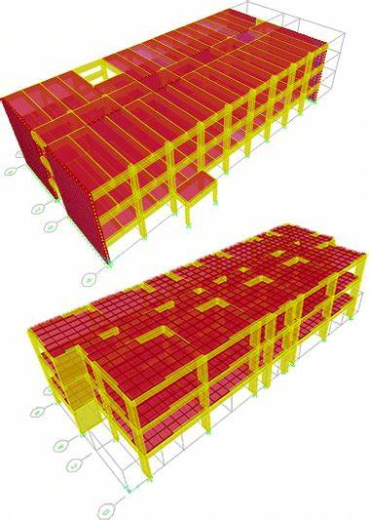
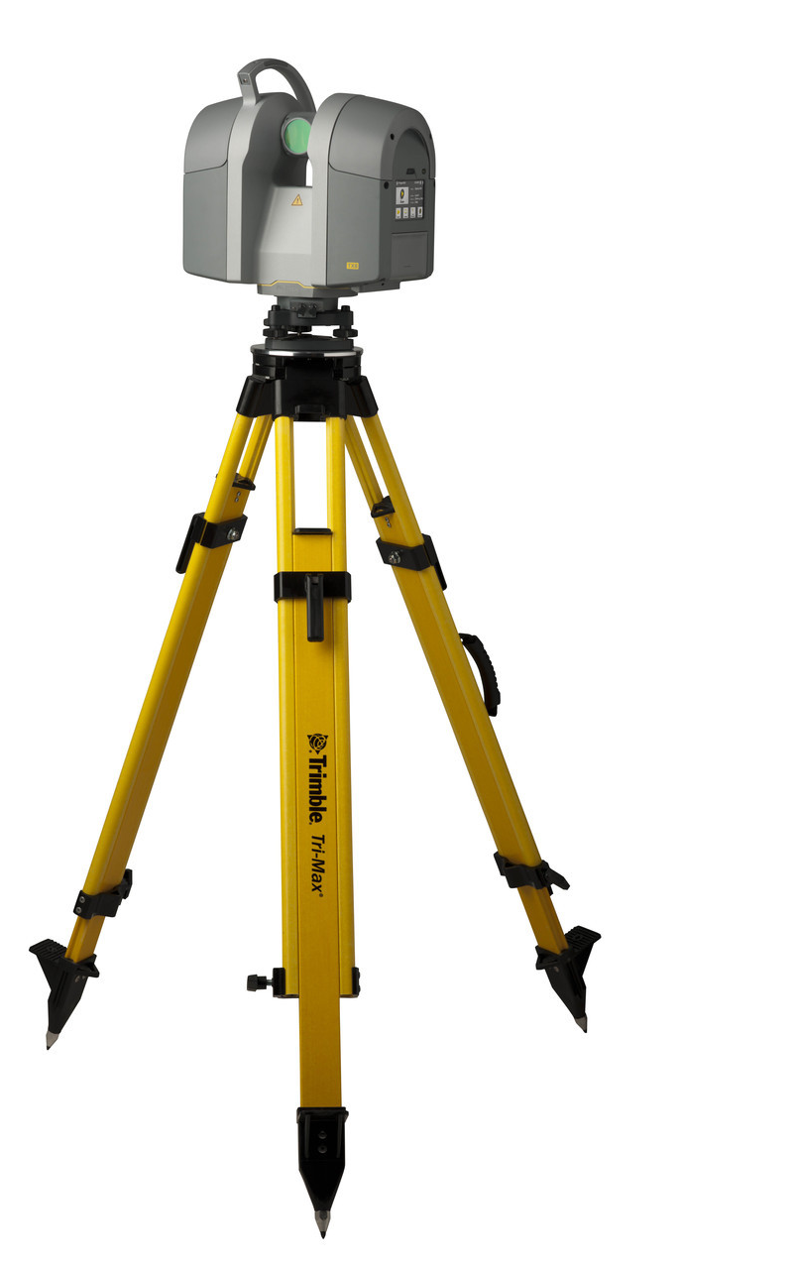
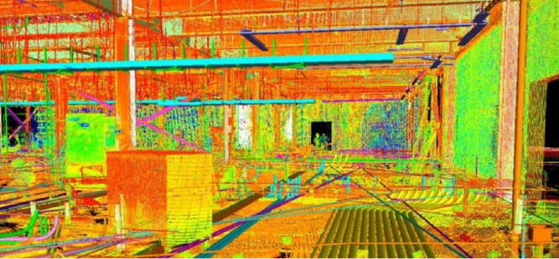



Introduction
Background
"Scan to BIM" process
As-design BIM model
Field Verification
3D Point Cloud Collection – without label
BIM model O&M
As-built BIM model

Slide 4
Introduction
Background
"Scan to BIM" process
3D Point cloud Semantic Segmentation
As-design BIM model
Field Verification
3D Point Cloud Collection – without label
BIM model O&M
As-built BIM model

Slide 5
Introduction
Background
"Scan to BIM" process
3D Point cloud Semantic Segmentation
As-design BIM model
Field Verification
3D Point Cloud Collection – without label
BIM model O&M
As-built BIM model
Manual process involved…
Limited amount of dataset…

Slide 6
Introduction
Background
3D Point Cloud Semantic Segmentation
Deep learning-based methods
Non Deep learning-based methods
Non-projection based deep learning method
Projection based deep learning methods

Slide 7
Introduction
Background
3D Point Cloud Semantic Segmentation
Is the process fully automated?
Is it applicable when there is a limited amount of dataset?
Deep learning-based methods
Non Deep learning-based methods
Non-projection based deep learning method
Projection based deep learning methods

Slide 8
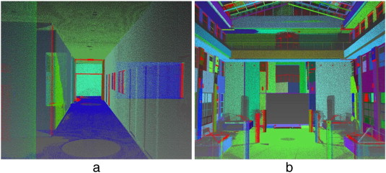
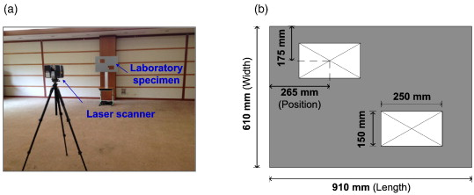
Introduction
Background
3D Point Cloud Semantic Segmentation
Is the process fully automated?
Is it applicable when there is a limited amount of dataset?
RANSAC – Classic but only for simple shapes [1]
Non Deep learning-based methods
(1950-2010)
Edge detection – rely on pre-defined features [2]

Slide 9
Introduction
Background
3D Point Cloud Semantic Segmentation
Is the process fully automated? - No
Is it applicable when there is a limited amount of dataset? - Yes
RANSAC – Classic but only for simple shapes [1]
Non Deep learning-based methods
(1950-2010)
Edge detection – rely on pre-defined features [2]

Slide 10
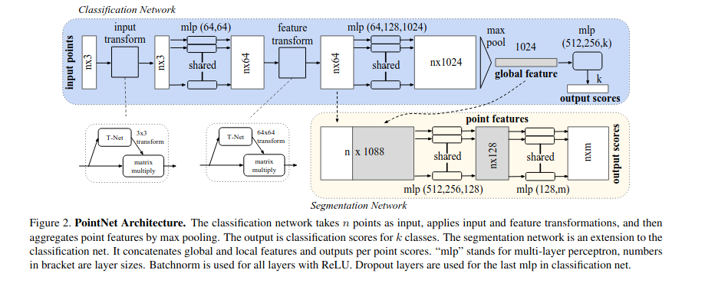
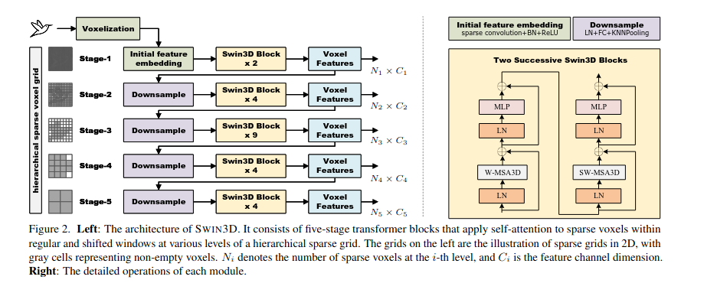
Introduction
Background
3D Point Cloud Semantic Segmentation
Is the process fully automated?
Is it applicable when there is a limited amount of dataset?
Deep learning-based methods
Non-projection based deep learning method
Projection based deep learning methods
3D Points as an input [3]
Voxel as an input [4]

Slide 11
Introduction
Background
3D Point Cloud Semantic Segmentation
Is the process fully automated? - Yes
Is it applicable when there is a limited amount of dataset? - No
Deep learning-based methods
Non-projection based deep learning method
Projection based deep learning methods
3D Points as an input [3]
Voxel as an input [4]

Slide 12
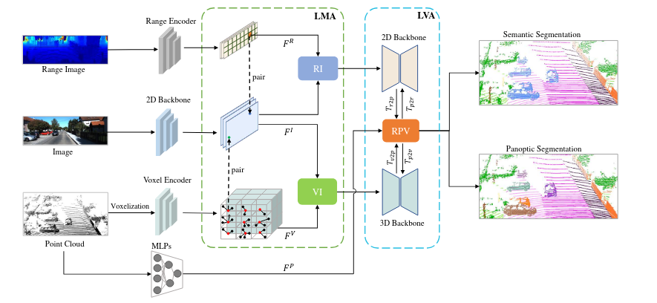
Introduction
Background
3D Point Cloud Semantic Segmentation
Is the process fully automated?
Is it applicable when there is a limited amount of dataset?
Deep learning-based methods
Non-projection based deep learning method
Projection based deep learning methods
Hybrid 2D & 3D as an input [5-8]

Slide 13
Introduction
Background
3D Point Cloud Semantic Segmentation
Is the process fully automated? - Yes
Is it applicable when there is a limited amount of dataset? - No
Deep learning-based methods
Non-projection based deep learning method
Projection based deep learning methods
Hybrid 2D & 3D as an input [5-8]

Slide 14
Motivation
Point of Departure
3D Point Cloud Semantic Segmentation
Is the process fully automated? - Yes
Is it applicable when there is a limited amount of dataset? - No
Deep learning-based methods
Non-projection based deep learning method
Projection based deep learning methods

Slide 15
Motivation
Point of Departure
3D Point Cloud Semantic Segmentation
Is the process fully automated? - Yes
Is it applicable when there is a limited amount of dataset? - No
What happens if we only rely on the 2D Image (i.e., Color) as an input for 3D Semantic Segmentation?
(limited 3D – unlimited 2D – 3D)
Deep learning-based methods
Non-projection based deep learning method
Projection based deep learning methods

Slide 16
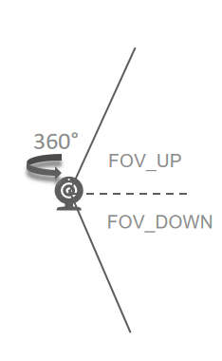
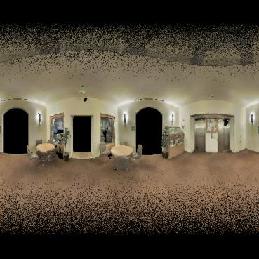
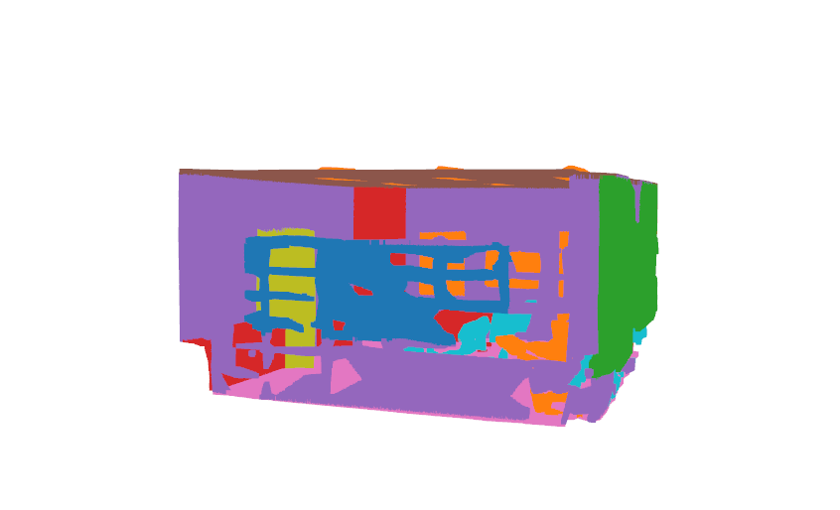
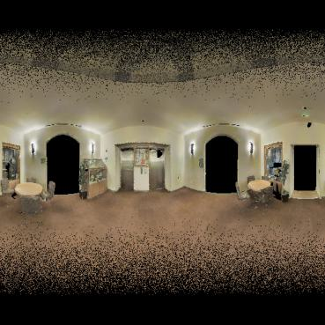
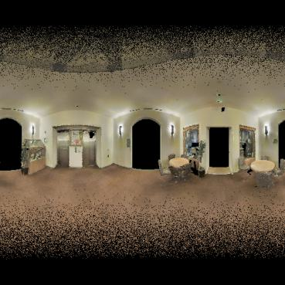
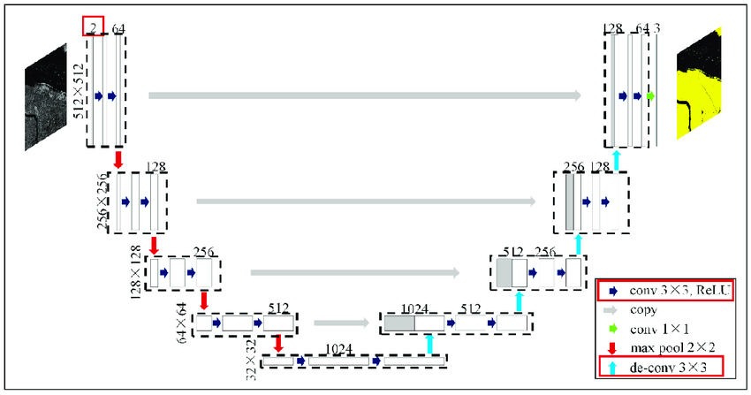

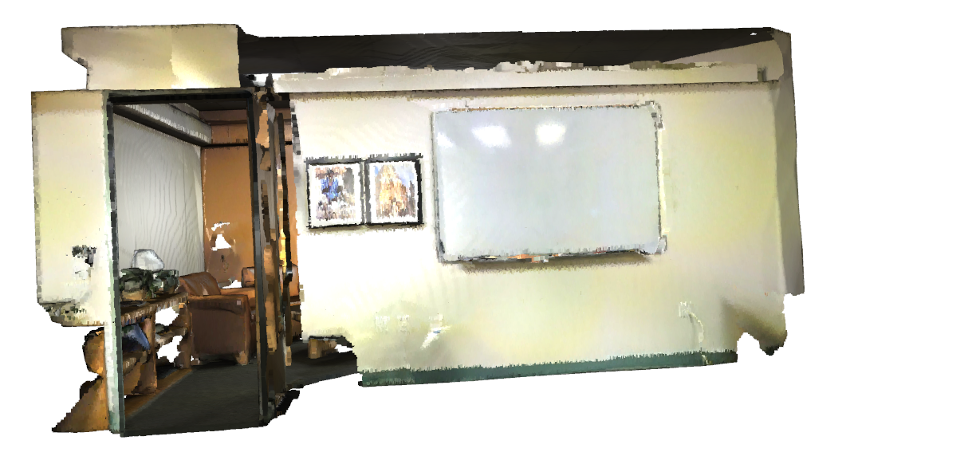
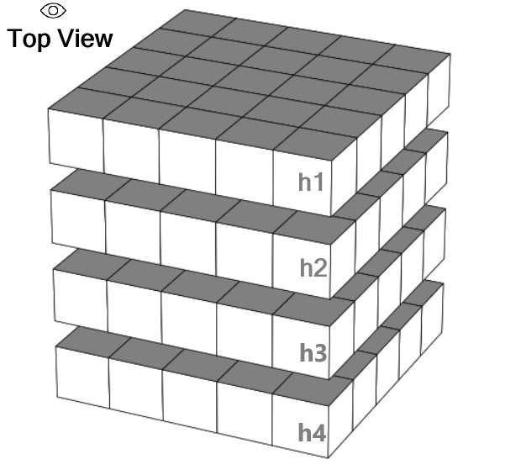
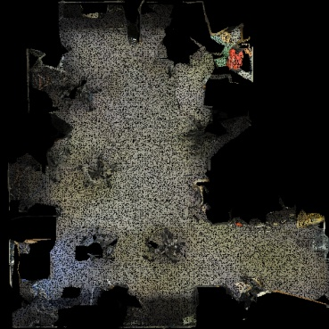
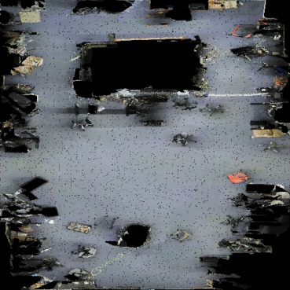
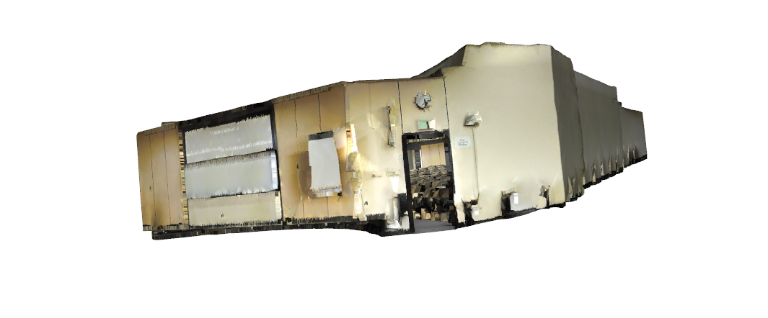
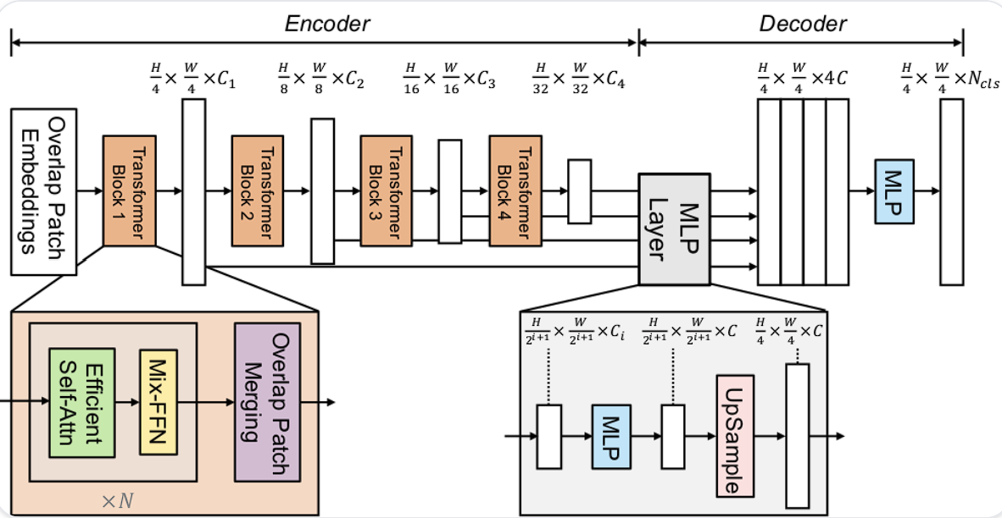
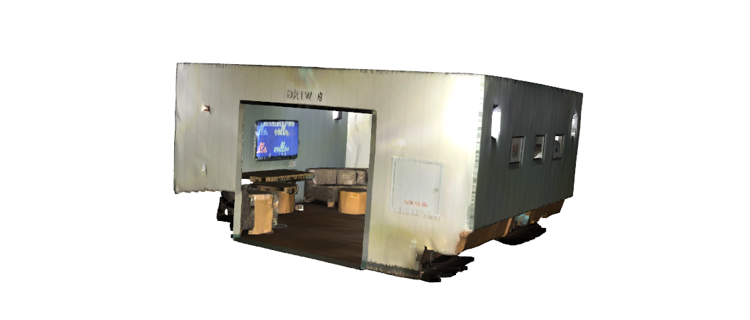
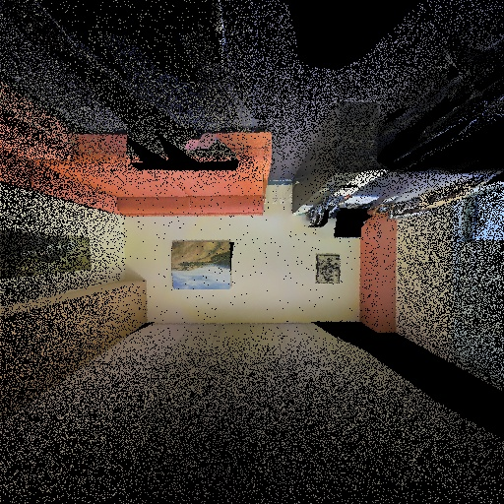
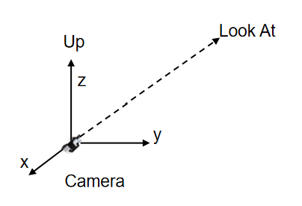
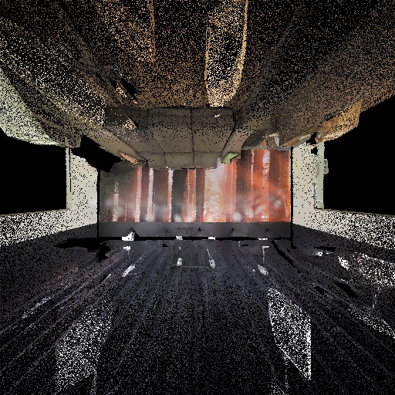
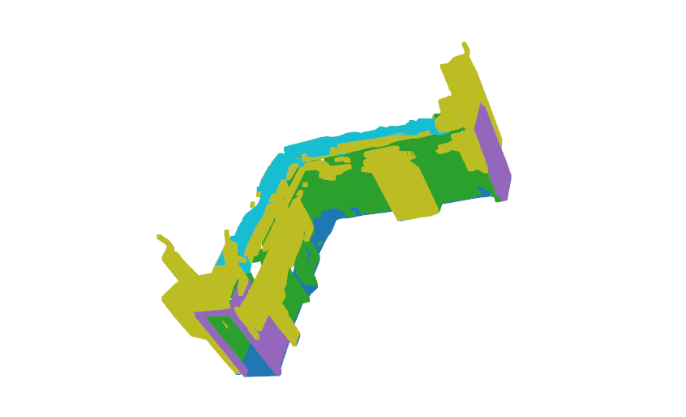
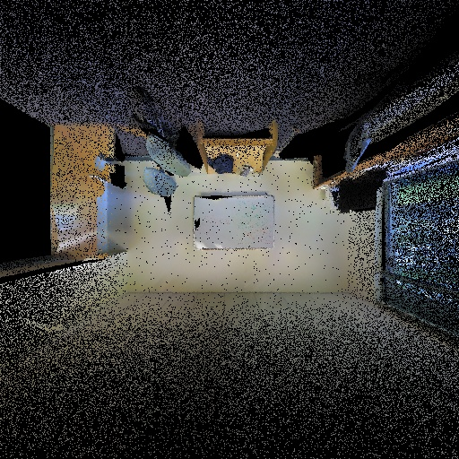
Methodology
Overarching 3D – 2D – 3D process
From 3D to 2D
From 2D back to 3D
SP
BEV
PP
Original 3D Scans
2D Convolutional Networks
Different Projection Methods
Reprojected 3D Semantic Point
Projected Images in 2D Domain

Slide 17
Methodology
Overarching 3D – 2D – 3D process
From 3D to 2D
From 2D back to 3D
SP
BEV
PP
Original 3D Scans
2D Convolutional Networks
Different Projection Methods
Reprojected 3D Semantic Point
Projected Images in 2D Domain

Slide 18
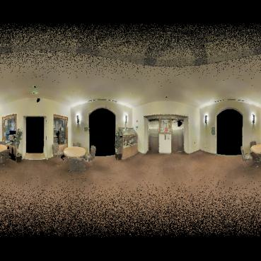
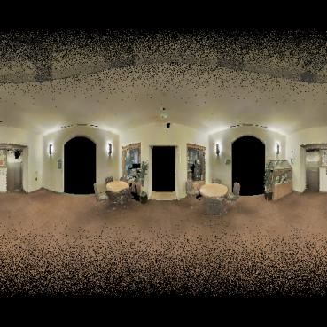
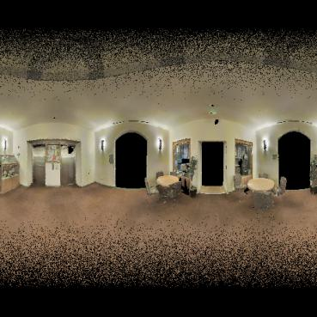
Methodology
Projection Method (1) Spherical Projection
Lounge Room

Slide 19
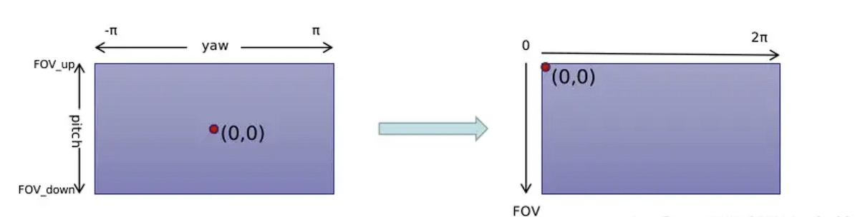
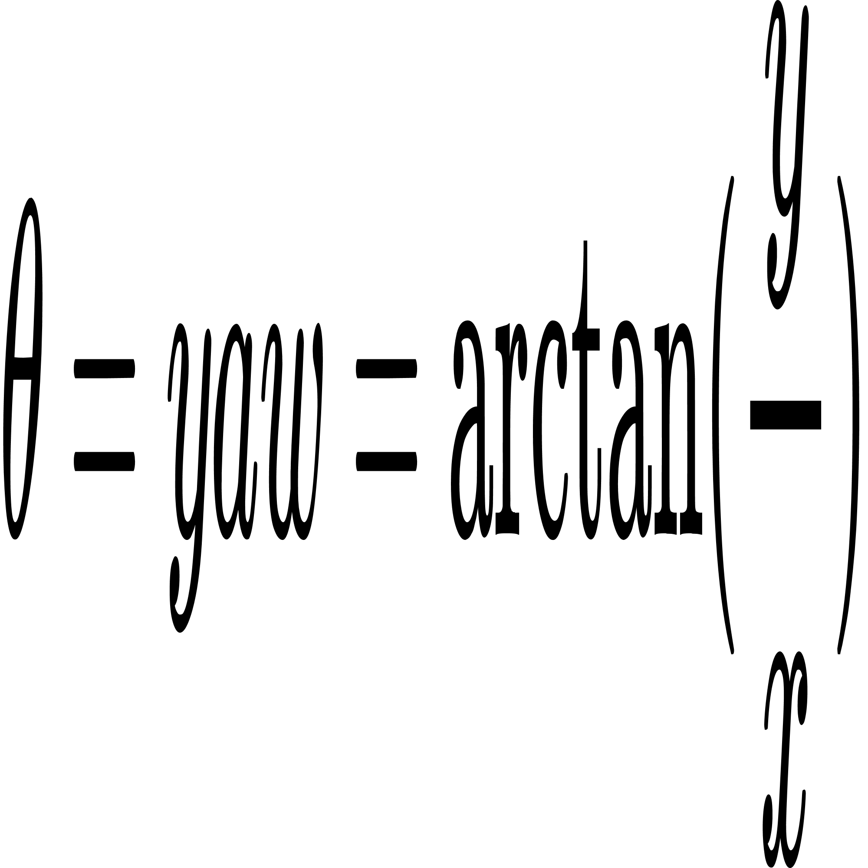
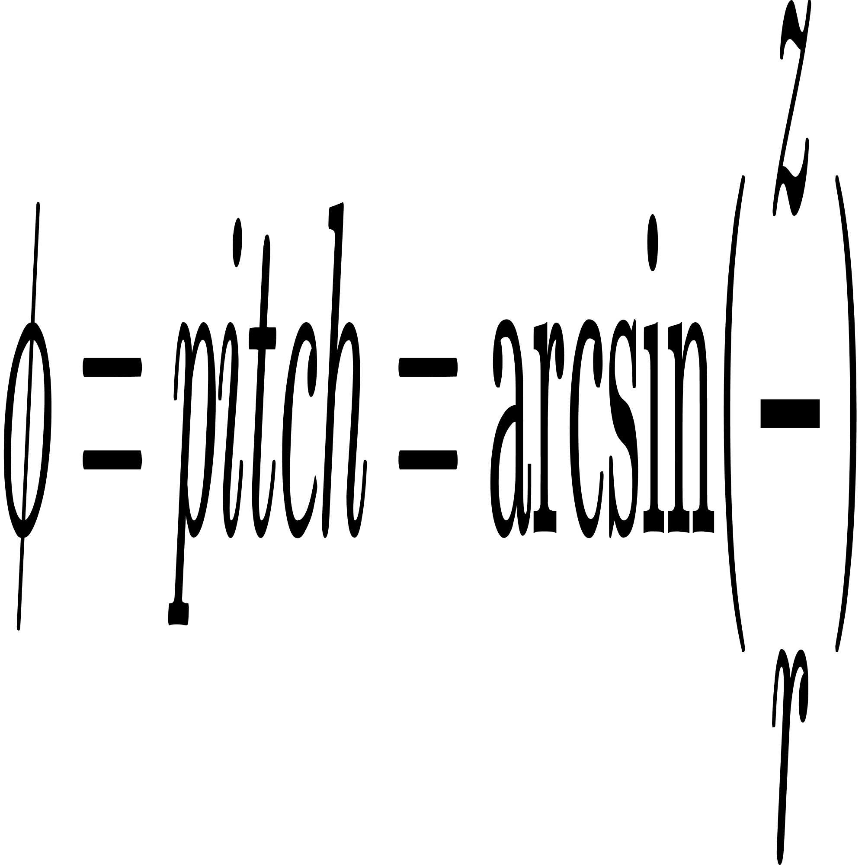
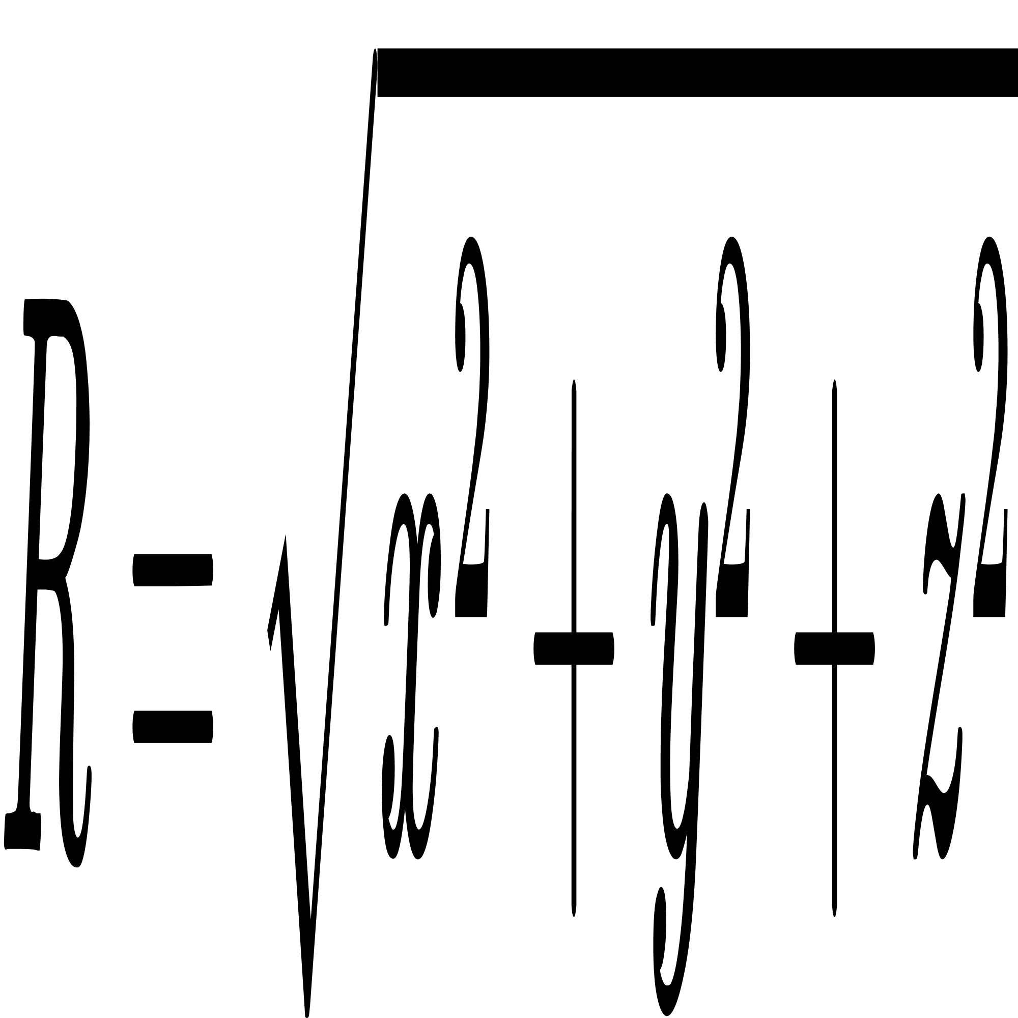
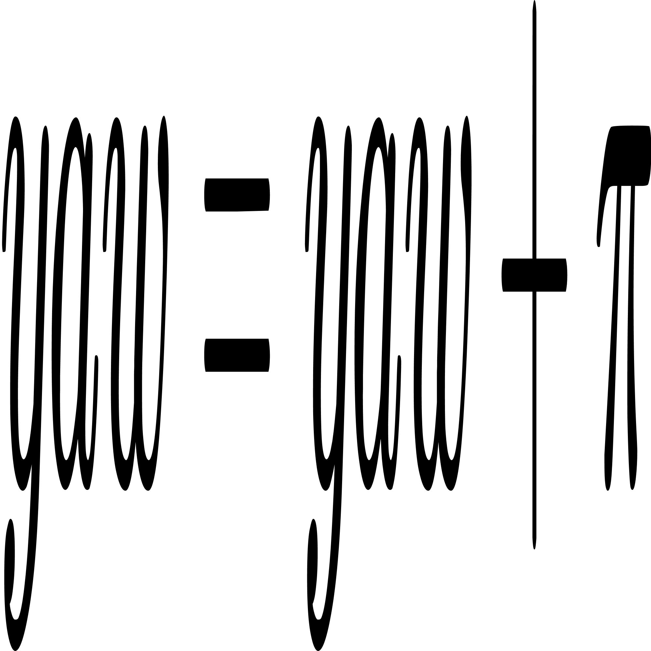
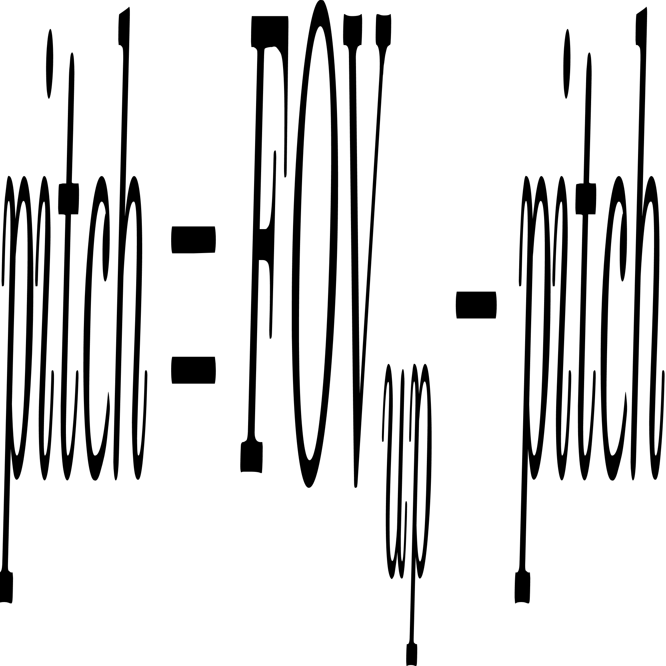

Methodology
Projection Method (1) Spherical Projection
1. Spherical Coordinate to X-Y plane
z
(x1, y1, z1)
2. X-Y plane Mapping
z1
r
pitch
y1
y
x1
yaw
d
x

Slide 20
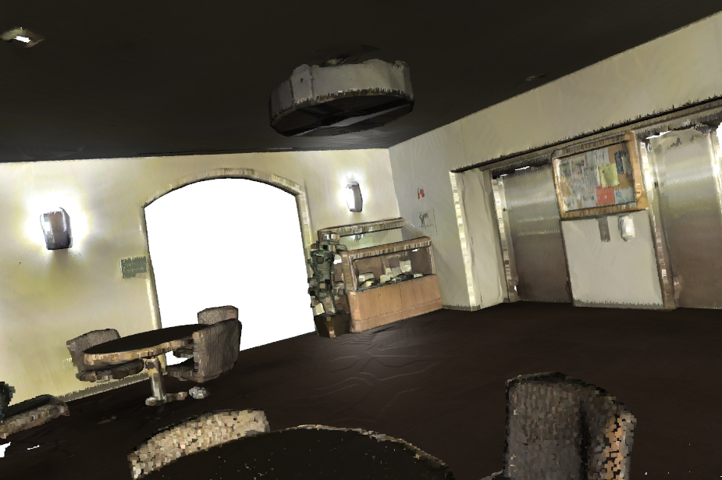
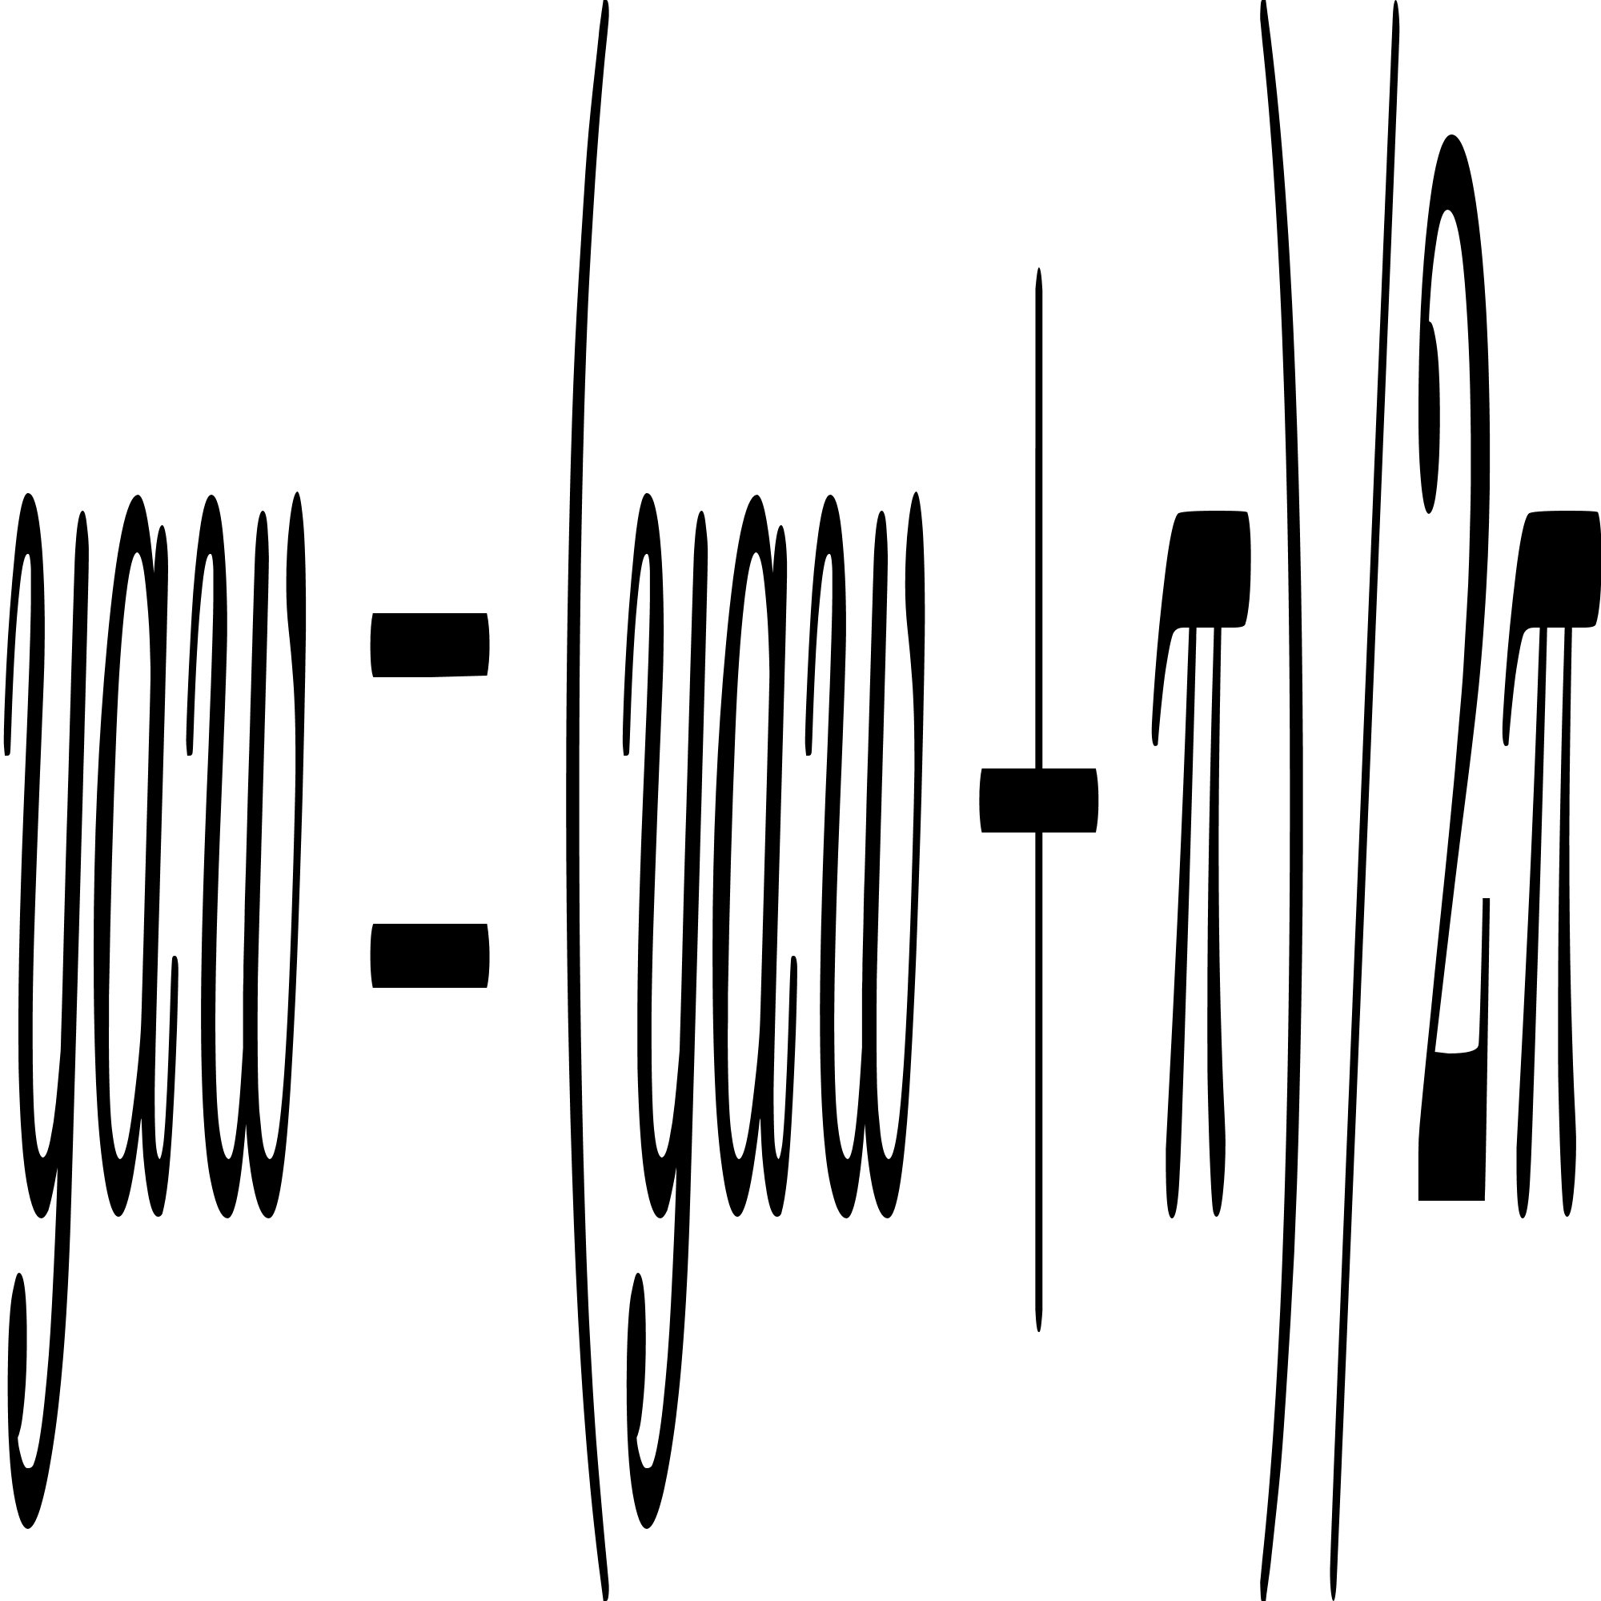
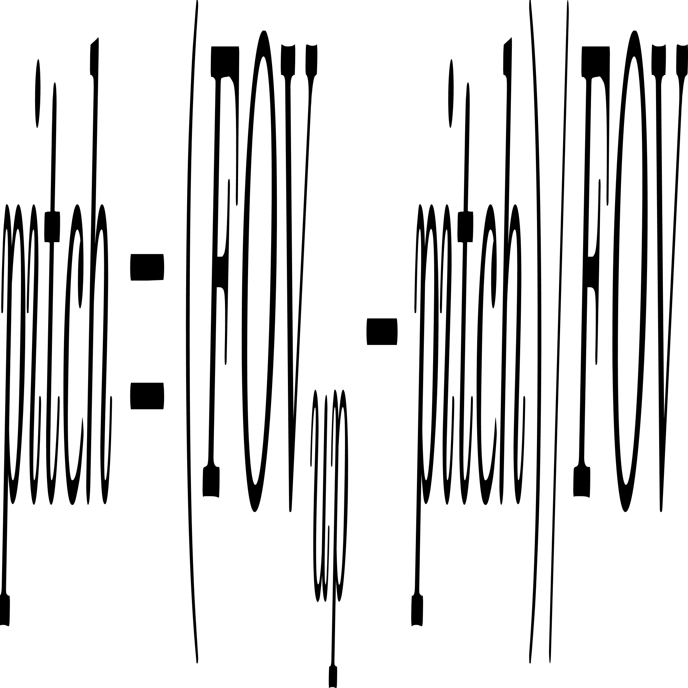
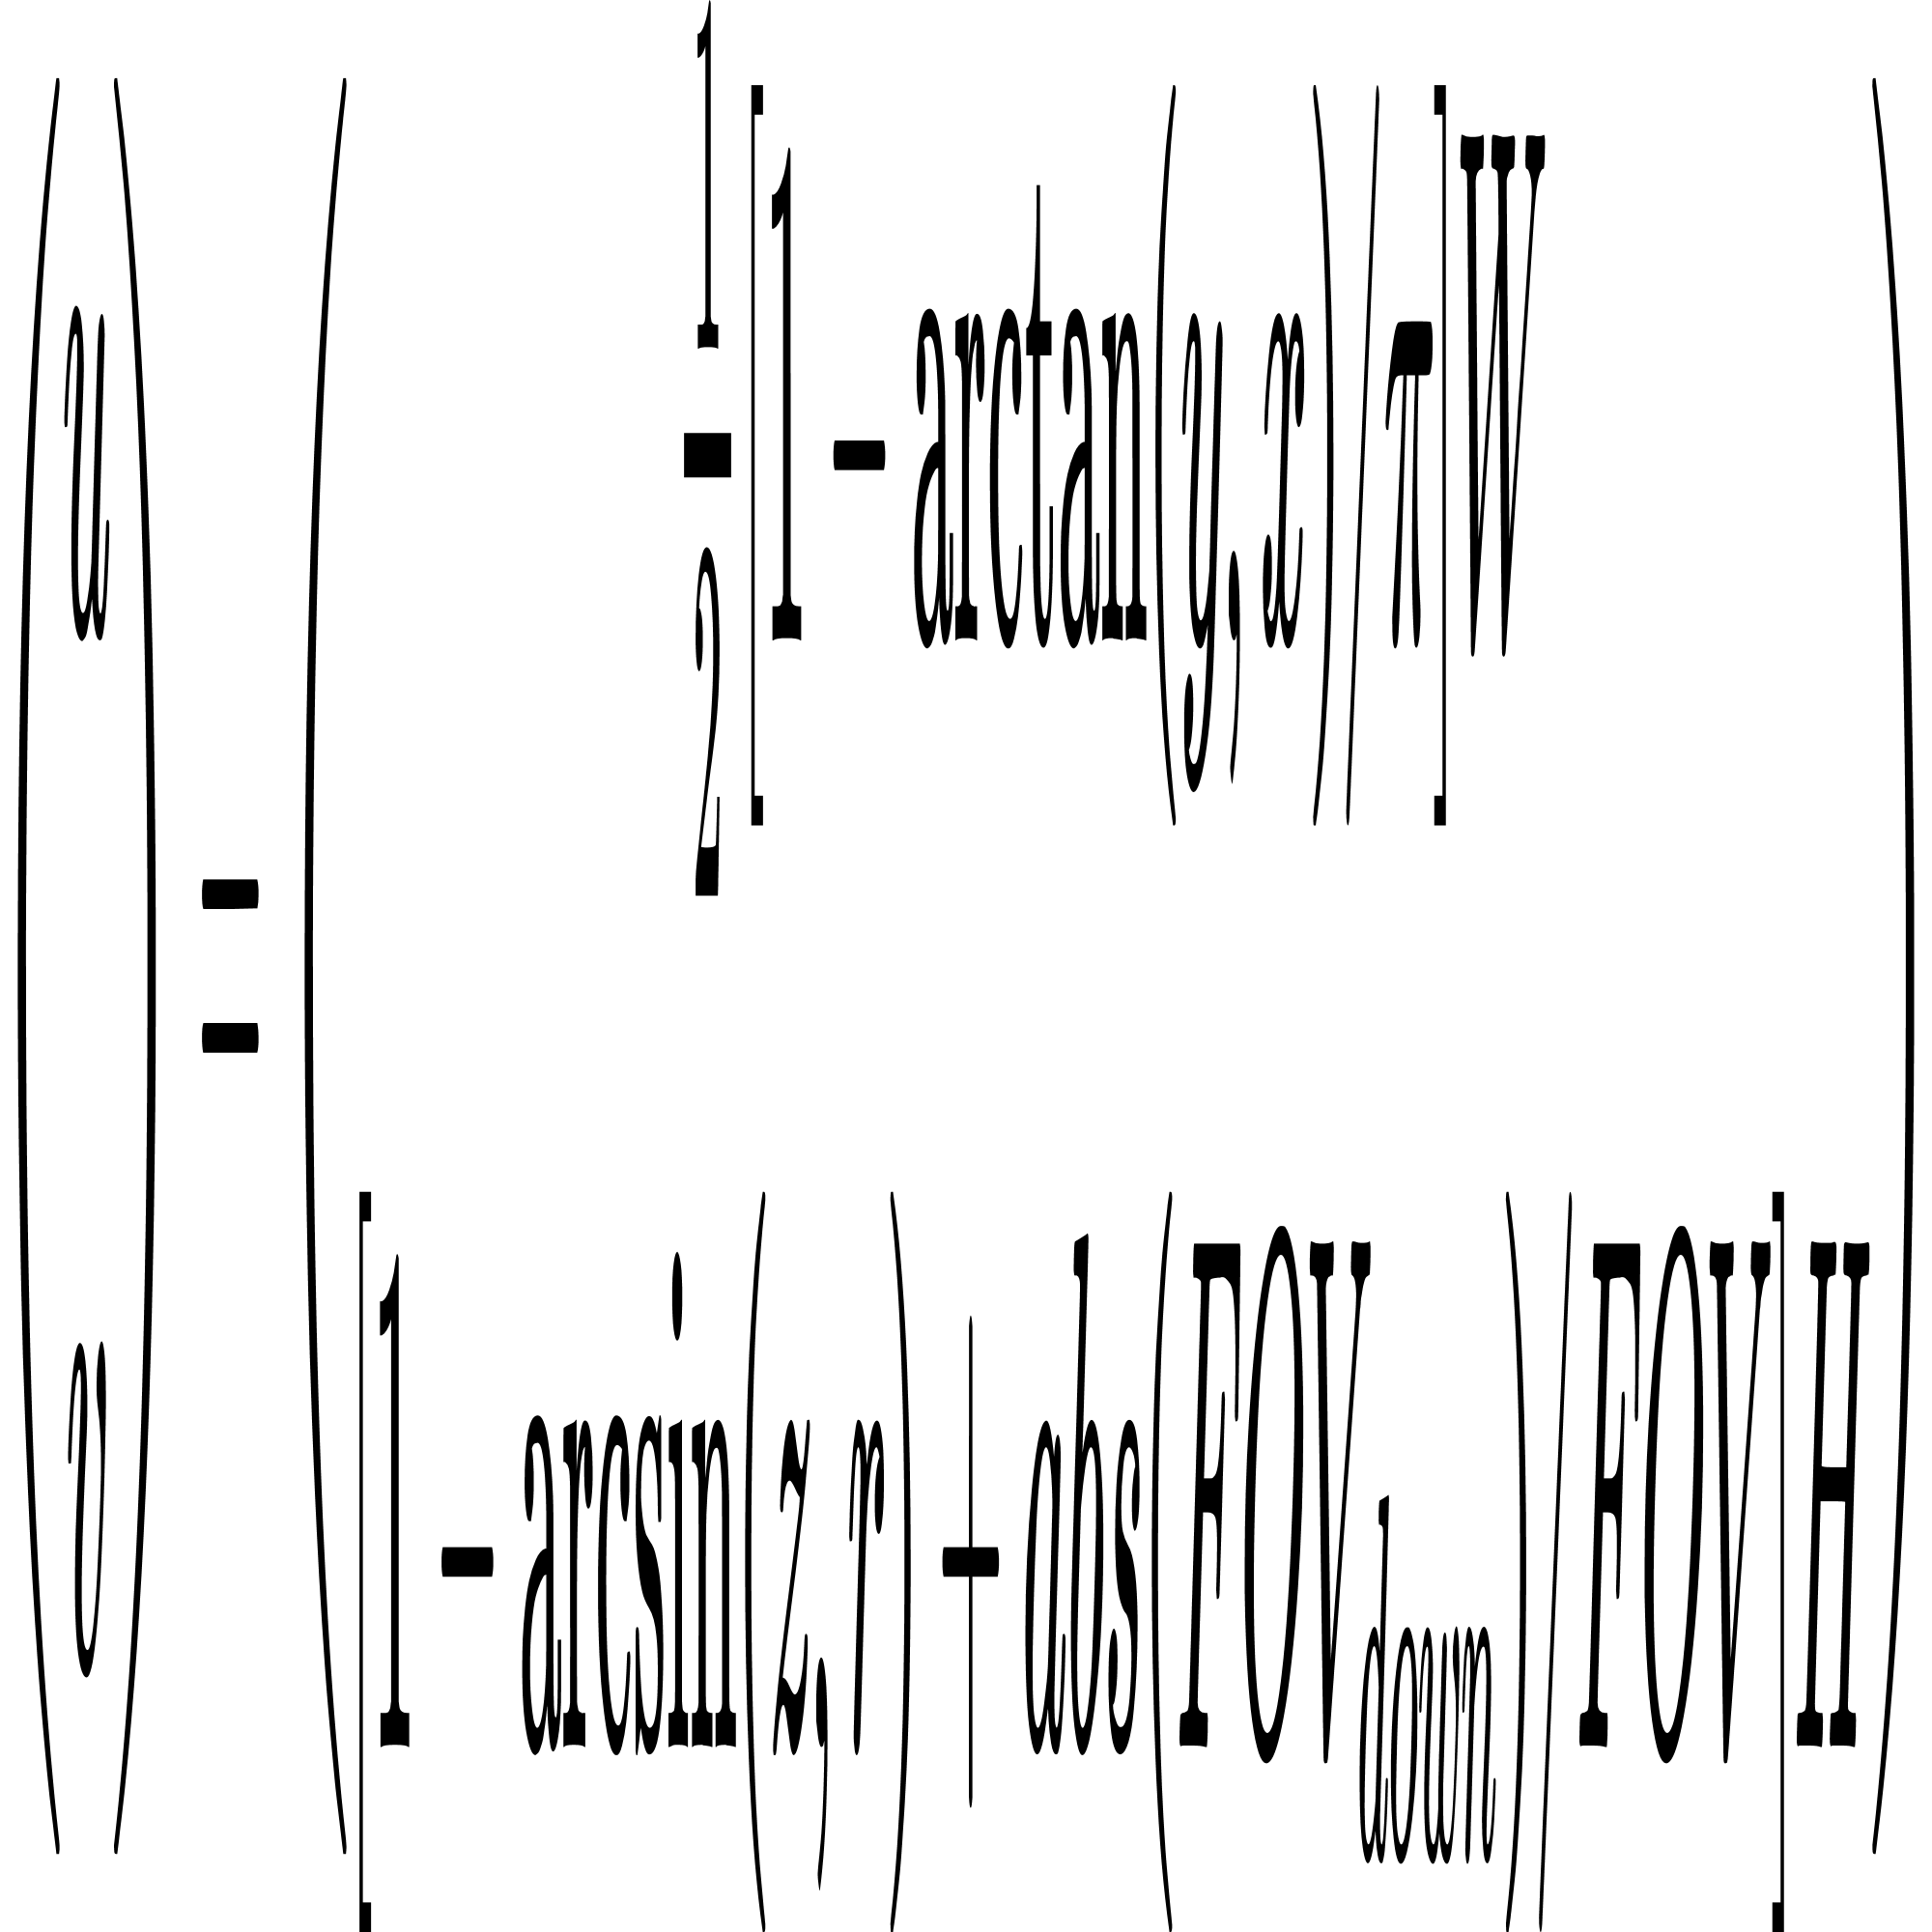
Methodology
Projection Method (1) Spherical Projection
3. X-Y plane Shifting
360°
FOV_UP
FOV_DOWN
Lounge 3D View
4. 3D to 2D Conversion
Lounge 2D Views from Spherical Projection

Slide 21


Methodology
Projection Method (1) Spherical Projection
Lounge Room
Pros:
Panoptic, Feature-Rich, Fast
Cons:
Distorted, Limited Size

Slide 22
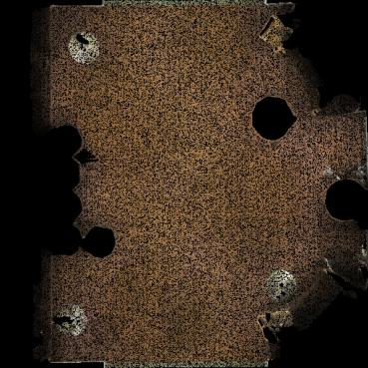

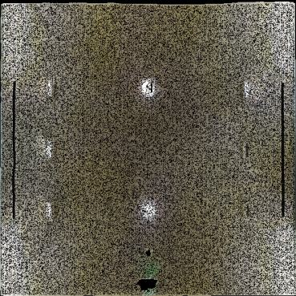
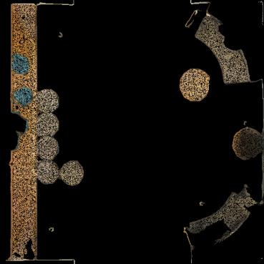
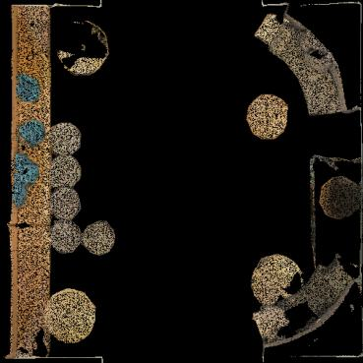
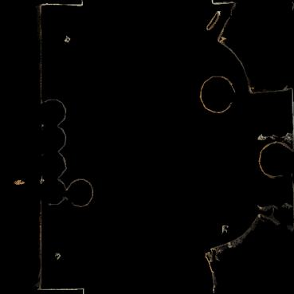
Methodology
Projection Method (2) Birds Eye View Projection
Orthogonal Projection
Lounge Room

Slide 23
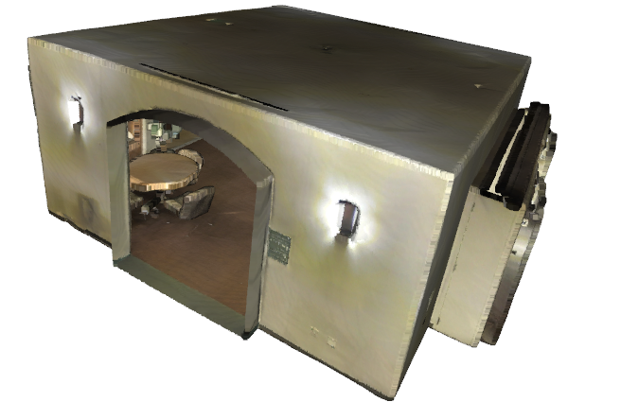
Methodology
Projection Method (2) Birds Eye View Projection
Orthogonal Projection
Algorithm:
*****************************************
For each p in 3d_dis:
x_p = x / res
y_p = y / res
z_p = z / res
...
x_img = (x_p / x_max) * Width
y_img = (y_p / y_max) * Height
*****************************************
h1
h2
h3
point attributes which has Z_max is kept in each unit
h4
R_img = p_zmax[:, 3]
G_img = p_zmax[:, 4]
B_img = p_zmax[:, 5]

Slide 24
Methodology
Projection Method (2) Birds Eye View Projection
Orthogonal Projection
Pros:
No distortion
Cons:
Limited features
Lounge Room

Slide 25
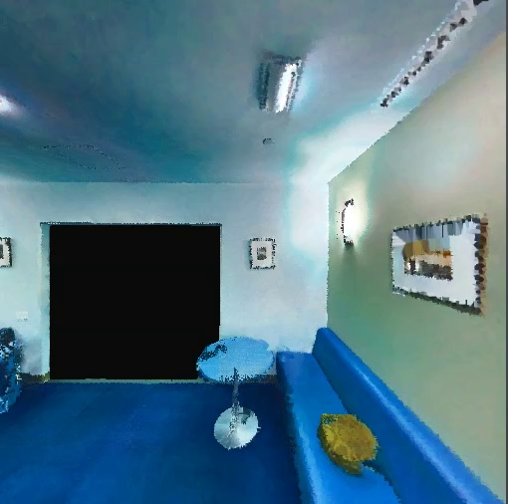
Methodology
Projection Method (3) Perspective Projection
Lounge Room

Slide 26
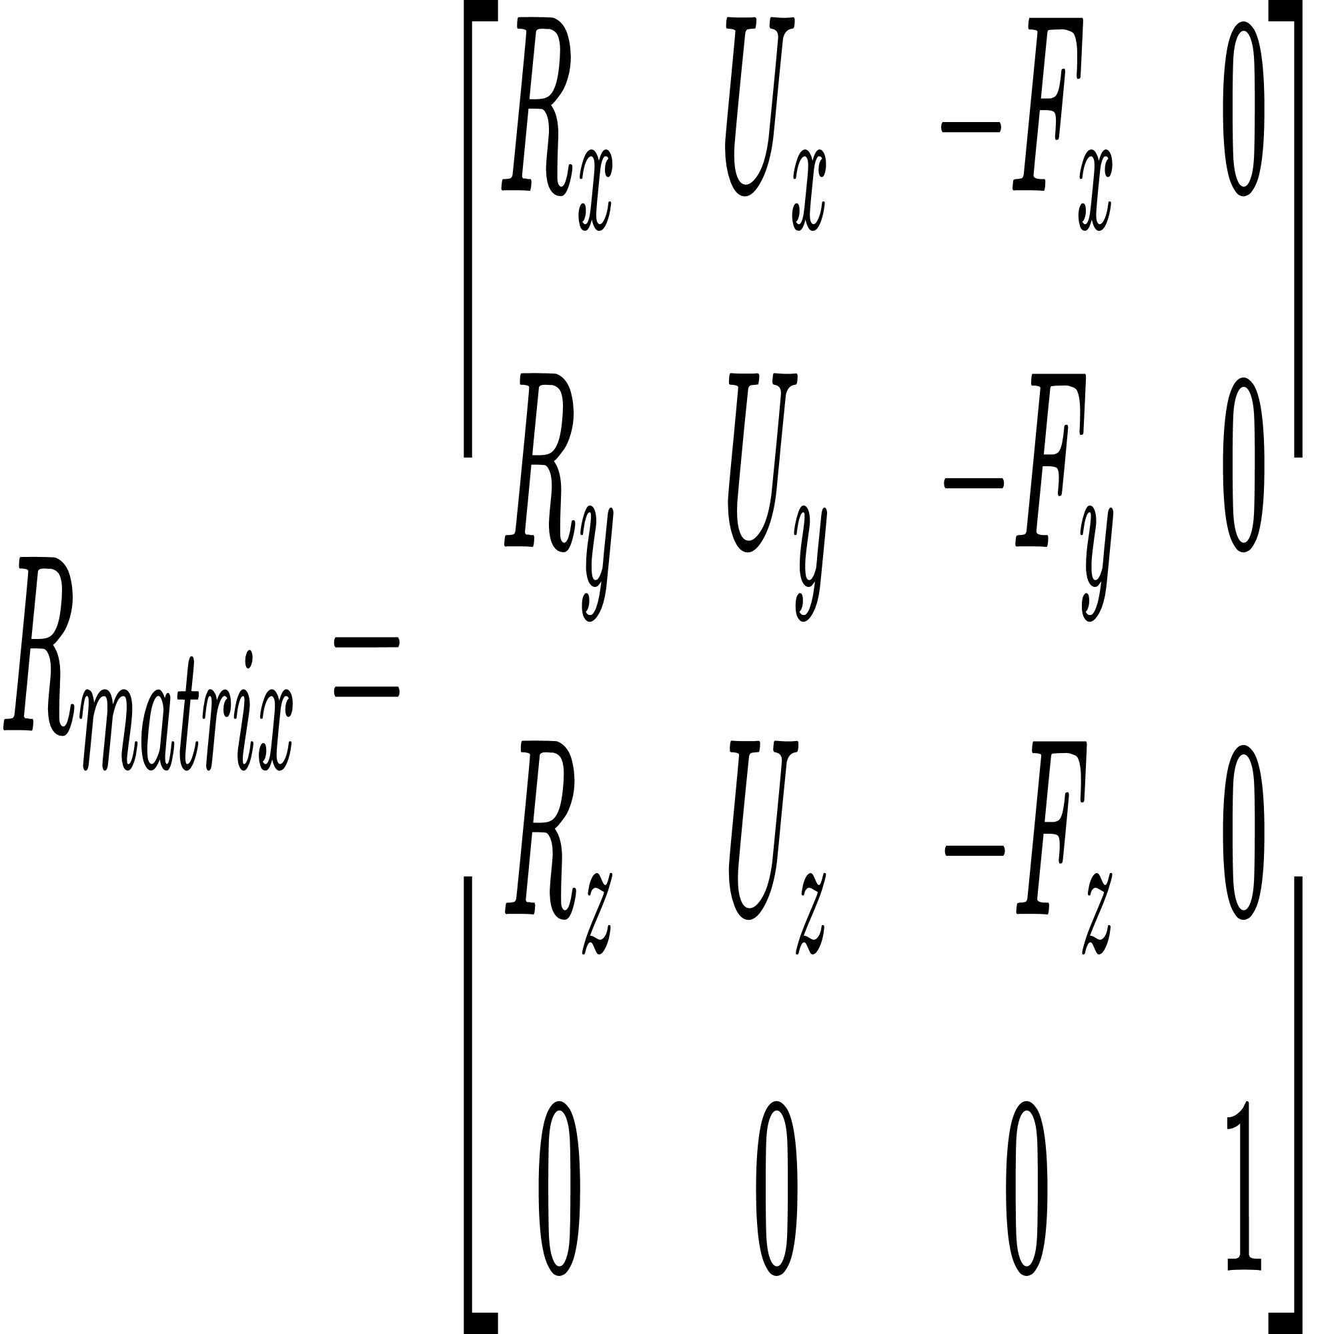
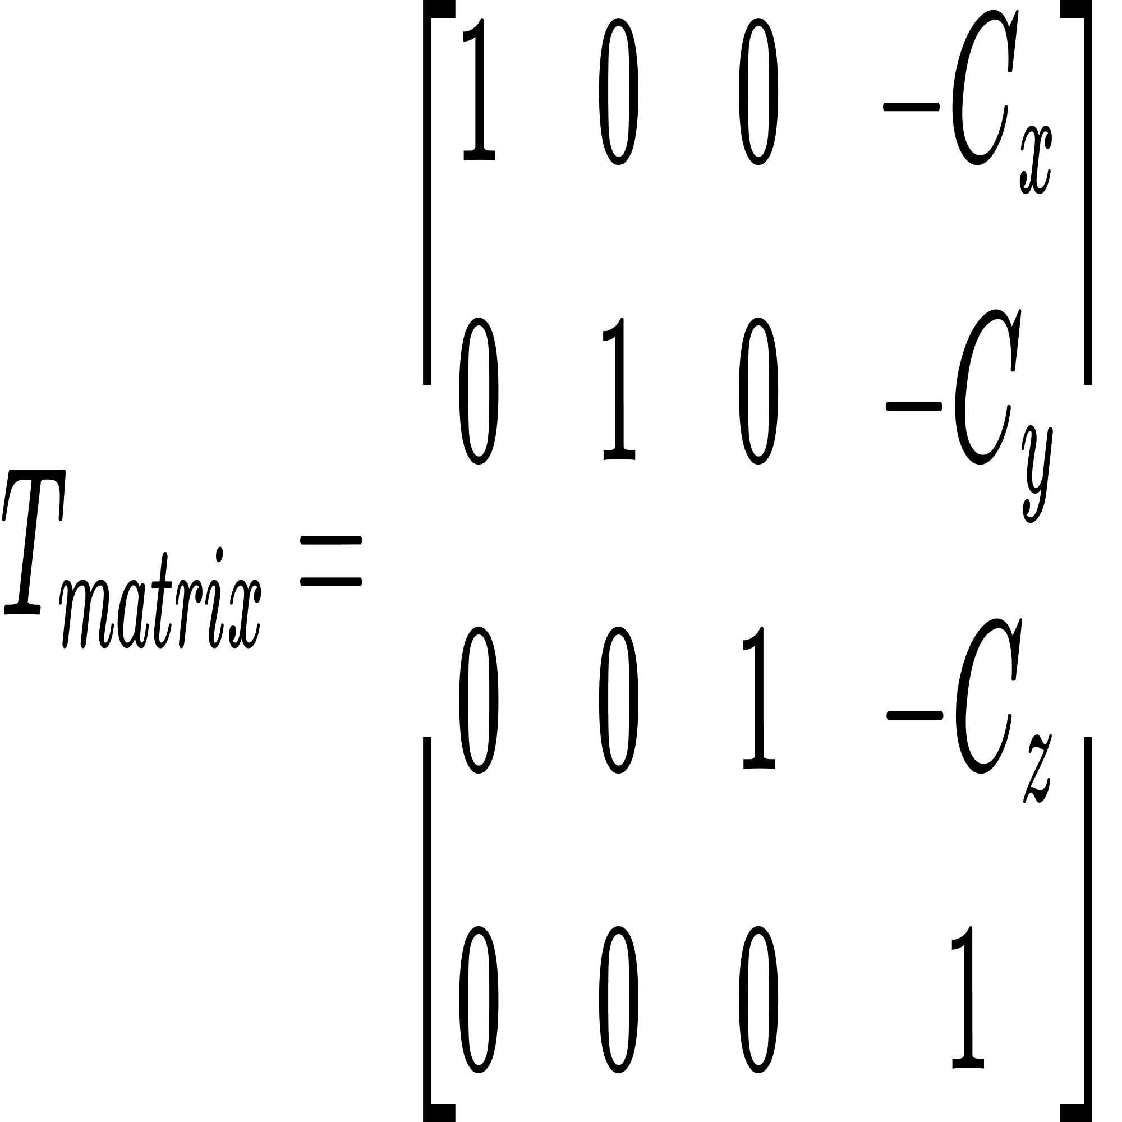




Methodology
Projection Method (3) Perspective Projection
1. World Coordinate System to Camera Coordinate System
2. For each 3D point:

Slide 27




Methodology
Projection Method (3) Perspective Projection
3. Perspective Projection:
4. Clip space to NDC:
5. NDC to Screen:

Slide 28


Methodology
Projection Method (3) Perspective Projection
Lounge Room
Pros:
Unlimited amount
Flexible spots
Cons:
Partial features/view per image

Slide 29
Methodology
Overarching 3D – 2D – 3D process
From 3D to 2D
From 2D back to 3D
SP
BEV
PP
Original 3D Scans
2D DL Networks
Different Projection Methods
Reprojected 3D Semantic Point
Projected Images in 2D Domain

Slide 30
Methodology
2D Semantic Segmentation
U-Net [16]
Advantages
High Accuracy in Segmentation
Effective with Limited Data
Preserves Fine Details
Efficient Training
Applications
Biomedical Image [9], AAA[10], AAAA [11]
Applications: Biomedical Image [9], AAA[10], AAAA [11]

Slide 31
Methodology
2D Semantic Segmentation
Segformer [17]
Advantages
Superior Performance
Enhanced Detail Capture
Effective Global Context Utilization
Efficient Training and Inference
Applications
Biomedical Image [12], AAA[13], AAAA [14]

Slide 32
Methodology
Overarching 3D – 2D – 3D process
From 3D to 2D
From 2D back to 3D
SP
BEV
PP
Original 3D Scans
2D Convolutional Networks
Different Projection Methods
Reprojected 3D Semantic Point
Projected Images in 2D Domain

Slide 33
Methodology
Backprojection from 2D to 3D
Most voting rule [18]
Assigning label to a 3D point based on the most frequently occurring label from multiple 2D semantic segmentation masks
for each i in back projection GT mask:
for (u, v) in mask i:
if point p in point cloud projected into (u, v):
append label(u, v) to corresponding (x_{p}, y_{p}, z_{p})
for each p in point cloud:
return class label has most appearance

Slide 34
Methodology
Backprojection from 2D to 3D
Most voting rule [18]
Assigning label to a 3D point based on the most frequently occurring label from multiple 2D semantic segmentation masks
for each i in back projection GT mask:
for (u, v) in mask i:
if point p in point cloud projected into (u, v):
append label(u, v) to corresponding (x_{p}, y_{p}, z_{p})
Information Loss!!!
for each p in point cloud:
return class label has most appearance

Slide 35
Methodology
Backprojection from 2D to 3D
Most voting rule [18]
Assigning label to a 3D point based on the most frequently occurring label from multiple 2D semantic segmentation masks
for each i in back projection GT mask:
for (u, v) in mask i:
if point p in point cloud projected into (u, v):
append label(u, v) to corresponding (x_{p}, y_{p}, z_{p})
Information Loss!!!
for each p in point cloud:
return class label has most appearance
Network | SP | BEV | PP
2D IoU (%) | 100.00 | 100.00 | 100.00
3D IoU (%) | 78.54 | 73.38 | 87.75
-21.46%
-26.62%
-12.25%
Notes:
majority voting counts the votes of the base learners and predicts the final labels as the label with the majority of votes.

Slide 36

Experimental Setup
Dataset
S3DIS Six large scale 3D Indoor Space Dataset
6 Areas 252 rooms (x, y, z, r, g, b) with 14 class label (e.g., chair, table, floor, ceiling, …)
Table. Room distribution across different area
Room Type | A1 | A2 | A3 | A4 | A5 | A6
Conference room | 2 | 1 | 1 | 3 | 3 | 1
Copy room | 1 | 0 | 0 | 0 | 0 | 1
Hallway | 8 | 12 | 6 | 14 | 15 | 6
Pantry | 1 | 0 | 0 | 0 | 1 | 1
Office | 31 | 14 | 10 | 22 | 42 | 37
WC | 1 | 2 | 2 | 4 | 2 | 0
Auditorium | 0 | 2 | 0 | 0 | 0 | 0
Storage | 0 | 9 | 2 | 4 | 4 | 0
Lounge | 0 | 0 | 2 | 0 | 0 | 1
Lobby | 0 | 0 | 0 | 2 | 1 | 0
Openspace | 0 | 0 | 0 | 0 | 0 | 1
Total | 44 | 40 | 23 | 49 | 68 | 48
6 Areas in S3DIS [1]

Slide 37
Experimental Setup
Two Experiments
Is the process fully automated? - Yes
Is it applicable when there is a limited amount of dataset? - No

Slide 38
Experimental Setup
Two Experiments
Is the process fully automated? - Yes
Is it applicable when there is a limited amount of dataset? - No
Experiment #1: Limited amount of dataset & Different environment for training and testing
Experiment #2: Limited amount of dataset & Similar environment for training and testing

Slide 39
Experimental Setup
Two Experiments
Is the process fully automated? - Yes
Is it applicable when there is a limited amount of dataset? - No
Experiment #1: Limited amount of dataset & Different environment for training and testing
Area 3: 23 rooms for training
Area 5: 68 rooms for testing
Room Type | A1 | A2 | A3 | A4 | A5 | A6
Conference room | 2 | 1 | 1 | 3 | 3 | 1
Copy room | 1 | 0 | 0 | 0 | 0 | 1
Hallway | 8 | 12 | 6 | 14 | 15 | 6
Pantry | 1 | 0 | 0 | 0 | 1 | 1
Office | 31 | 14 | 10 | 22 | 42 | 37
WC | 1 | 2 | 2 | 4 | 2 | 0
Auditorium | 0 | 2 | 0 | 0 | 0 | 0
Storage | 0 | 9 | 2 | 4 | 4 | 0
Lounge | 0 | 0 | 2 | 0 | 0 | 1
Lobby | 0 | 0 | 0 | 2 | 1 | 0
Openspace | 0 | 0 | 0 | 0 | 0 | 1
Total | 44 | 40 | 23 | 49 | 68 | 48

Slide 40


Experimental Setup
Two Experiments
Is the process fully automated? - Yes
Is it applicable when there is a limited amount of dataset? - No
Experiment #1: Limited amount of dataset & Different environment for training and testing
Area 3: 23 rooms for training
Area 5: 68 rooms for testing
Area 3 (23 rooms)
Area 5 (68 rooms)

Slide 41
Experimental Setup
Two Experiments
Is the process fully automated? - Yes
Is it applicable when there is a limited amount of dataset? - No
Experiment #2: Limited amount of dataset & Similar environment for training and testing
One room per room type for training
(10 rooms)
One room per room type for testing
(10 rooms)
Room Type | Training | Test
Conference room | Area 5_3 | Area 5_1
Copy room | Area 1_1 | Area 6_1
Hallway | Area 5_3 | Area 5 _12
Pantry | Area 1_1 | Area 6_1
Office | Area 5_3 | Area 5_18
WC | Area 3 _2 | Area 5 _1
Auditorium | Area 2_1 | Area 2_2
Storage | Area 3 _3 | Area 4 _1
Lounge | Area 3_2 | Area 3_1
Lobby | Area 4 _2 | Area 5 _1
Openspace | 0 | 0
Total | 10 | 10

Slide 42
Results
Experiment #1 – Quantitative Analysis
Dividing test groups per different projection method & 2D semantic segmentation
Test Group | Projection Method | Images per room | 2D Sem. Seg. Models
1 | Spherical Projection | 16 | U-Net
2 | Spherical Projection | 16 | Segformer
3 | Birds Eye View | 16 | U-Net
4 | Birds Eye View | 16 | Segformer
Class | Clutter | Beam | Column | Wall | Ceiling | Floor | Bookcase | Door | Chair | Board | Sofa | Window | Table | 2D mIoU (%) | 3DmIoU(%)
1 | 22.65 | 0.01 | 1.17 | 57 | 71.31 | 54.91 | 41.69 | 19.91 | 16.96 | 37.06 | 0.16 | 2.12 | 28.76 | 48.76 | 34.65
2 | 17.19 | 0 | 1.43 | 51.44 | 61.25 | 52.70 | 40.61 | 30.35 | 15.52 | 37.21 | 0.01 | 4.75 | 26.64 | 45.45 | 42.20
3 | 9.78 | 0 | 0 | 32.87 | 21.20 | 0.02 | 16.47 | 0.35 | 5.57 | 0.32 | 0.01 | 0.04 | 10.46 | 21.92 | 4.23
4 | 10.02 | 0.24 | 0.22 | 18.21 | 9.01 | 5.02 | 12.82 | 1.50 | 7.96 | 0.03 | 0.22 | 1.10 | 9.93 | 17.24 | 6.60

Slide 43
Results
Experiment #1 – Quantitative Analysis
Dividing test groups per different projection method & 2D semantic segmentation
Test Group | Projection Method | Images per room | 2D Sem. Seg. Models
1 | Spherical Projection | 16 | U-Net
2 | Spherical Projection | 16 | Segformer
3 | Birds Eye View | 16 | U-Net
4 | Birds Eye View | 16 | Segformer
Class | Clutter | Beam | Column | Wall | Ceiling | Floor | Bookcase | Door | Chair | Board | Sofa | Window | Table | 2D mIoU (%) | 3DmIoU(%)
1 | 22.65 | 0.01 | 1.17 | 57 | 71.31 | 54.91 | 41.69 | 19.91 | 16.96 | 37.06 | 0.16 | 2.12 | 28.76 | 48.76 | 34.65
2 | 17.19 | 0 | 1.43 | 51.44 | 61.25 | 52.70 | 40.61 | 30.35 | 15.52 | 37.21 | 0.01 | 4.75 | 26.64 | 45.45 | 42.20
3 | 9.78 | 0 | 0 | 32.87 | 21.20 | 0.02 | 16.47 | 0.35 | 5.57 | 0.32 | 0.01 | 0.04 | 10.46 | 21.92 | 4.23
4 | 10.02 | 0.24 | 0.22 | 18.21 | 9.01 | 5.02 | 12.82 | 1.50 | 7.96 | 0.03 | 0.22 | 1.10 | 9.93 | 17.24 | 6.60

Slide 44
Results
Experiment #1 – Quantitative Analysis
Dividing test groups per different projection method & 2D semantic segmentation
Test Group | Projection Method | Images per room | CNN Model
5 | Perspective Projection | 16 | U-Net
6 | Perspective Projection | 80 | U-Net
7 | Perspective Projection | 160 | U-Net
8 | Perspective Projection | 240 | U-Net
9 | Perspective Projection | 16 | Segformer
10 | Perspective Projection | 80 | Segformer
11 | Perspective Projection | 160 | Segformer
12 | Perspective Projection | 240 | Segformer

Slide 45
Results
Experiment #1 – Quantitative Analysis
Dividing test groups per different projection method & 2D semantic segmentation
Class | Clutter | Beam | Column | Wall | Ceiling | Floor | Bookcase | Door | Chair | Board | Sofa | Window | Table | 2D mIoU (%) | 3DmIoU(%)
5 | 19 | 0.11 | 0.09 | 61.17 | 75.97 | 65.87 | 44.58 | 2.79 | 5.06 | 40.91 | 0.19 | 0.82 | 25.56 | 51.55 | 26.06
6 | 22.43 | 0 | 0.61 | 64.01 | 82.71 | 66.58 | 50.26 | 5.88 | 9.43 | 43.92 | 0.18 | 4.20 | 30.15 | 55.10 | 26.33
7 | 24.61 | 0 | 0.82 | 64.87 | 81.74 | 72.64 | 52.81 | 7.79 | 13.60 | 49.60 | 0 | 4.93 | 34.93 | 57.42 | 35.84
8 | 26.54 | 0.04 | 0.43 | 67.24 | 84.32 | 75.54 | 57.36 | 12.94 | 16.07 | 54.36 | 0.15 | 5.08 | 34.85 | 60.60 | 47.21
9 | 16.50 | 0.15 | 0.14 | 44.96 | 41.51 | 37.58 | 35.78 | 11.85 | 6.91 | 28.35 | 0.17 | 10.77 | 23.55 | 36.40 | 26.49
10 | 19.22 | 0 | 0.07 | 46.80 | 43.52 | 39.81 | 35.21 | 21.53 | 10.42 | 31.46 | 0.02 | 12.50 | 26.04 | 38.33 | 33.77
11 | 18.58 | 0 | 0.06 | 47.21 | 44.58 | 38.96 | 36.65 | 11.54 | 10.16 | 33.05 | 0 | 10.53 | 24.12 | 38.51 | 32.88
12 | 18.74 | 0 | 0.05 | 47.14 | 44.44 | 38.88 | 36.69 | 12.08 | 10.93 | 32.93 | 0.09 | 11.69 | 25.21 | 38.54 | 35.05

Slide 46
Results
Experiment #1 – Quantitative Analysis
Dividing test groups per different projection method & 2D semantic segmentation
Class | Clutter | Beam | Column | Wall | Ceiling | Floor | Bookcase | Door | Chair | Board | Sofa | Window | Table | 2D mIoU (%) | 3DmIoU(%)
5 | 19 | 0.11 | 0.09 | 61.17 | 75.97 | 65.87 | 44.58 | 2.79 | 5.06 | 40.91 | 0.19 | 0.82 | 25.56 | 51.55 | 26.06
6 | 22.43 | 0 | 0.61 | 64.01 | 82.71 | 66.58 | 50.26 | 5.88 | 9.43 | 43.92 | 0.18 | 4.20 | 30.15 | 55.10 | 26.33
7 | 24.61 | 0 | 0.82 | 64.87 | 81.74 | 72.64 | 52.81 | 7.79 | 13.60 | 49.60 | 0 | 4.93 | 34.93 | 57.42 | 35.84
8 | 26.54 | 0.04 | 0.43 | 67.24 | 84.32 | 75.54 | 57.36 | 12.94 | 16.07 | 54.36 | 0.15 | 5.08 | 34.85 | 60.60 | 47.21
9 | 16.50 | 0.15 | 0.14 | 44.96 | 41.51 | 37.58 | 35.78 | 11.85 | 6.91 | 28.35 | 0.17 | 10.77 | 23.55 | 36.40 | 26.49
10 | 19.22 | 0 | 0.07 | 46.80 | 43.52 | 39.81 | 35.21 | 21.53 | 10.42 | 31.46 | 0.02 | 12.50 | 26.04 | 38.33 | 33.77
11 | 18.58 | 0 | 0.06 | 47.21 | 44.58 | 38.96 | 36.65 | 11.54 | 10.16 | 33.05 | 0 | 10.53 | 24.12 | 38.51 | 32.88
12 | 18.74 | 0 | 0.05 | 47.14 | 44.44 | 38.88 | 36.69 | 12.08 | 10.93 | 32.93 | 0.09 | 11.69 | 25.21 | 38.54 | 35.05
Perspective Projection showed the highest performance
Increased number of training data showed increased performance

Slide 47













Results
Experiment #1 – Qualitative Analysis (2D prediction)
Conference Room
Office
GT
Prediction
GT
Prediction
SP:
BEV:
PP:

Slide 48







Results
Experiment #1 – Qualitative Analysis (3D Images)
GT
SP
PP
Office
Conference Room

Slide 49
Results
Experiment #1 – Summary
Projection method – PP > SP > BEV
U-Net > Segformer
Simple class (e.g., ) > complex and less presented class (e.g,)
Applicability Validation of our Framework
 | Training | Testing | Accuracy
Ours | Area 3 | Area 5 | 47.21%
Ours | Area 1,2,3,4,6 | Area 5 | 60.68%
(Point-based) PointNet [19] | Area 1,2,3,4,6 | Area 5 | 41.1%
OmniVec [20] | Area 1,2,3,4,6 | Area 5 | 75.9%

Slide 50
Results
Experiment #2 – Quantitative Analysis
Limited amount of dataset & Similar environment
(Training 10 rooms & Testing 10 rooms)
Room | ConferenceRoom | CopyRoom | Hallway
3D IoU(%) | 51.81 | 42.24 | 93.54
Room | Pantry | Office | WC
3D IoU(%) | 52.15 | 43.49 | 67.79
Room | Auditorium | Storage | Lounge
3D IoU(%) | 24.72 | 70.62 | 49.67
Room | Lobby |  | Overall
3D IoU(%) | 64.26 |  | 56.23

Slide 51






Results
Experiment #2 – Qualitative Analysis
Limited amount of dataset & Similar environment
(Training 10 rooms & Testing 10 rooms)
GT
Prediction
Office
Hallway
Lounge

Slide 52
Discussion
Unbalanced class made less accuracy
Perspective Projection methods works on data restrained environment
More 2D images, more images for back projection process, less information loss
More pictures about on under-represented class (figure about chair)

Slide 53
Future Direction
Weigted most-updating rule
Externel Data augmentation on under-presented class
Better 2D CNN architecture (Challenges are on 2D!)

Slide 54
Contributions
Validate the projejction based approach
Investigated the difference and limitation of each projection method
Provided a reference case study applicable to other data scarcity scenarios

Slide 55
Conclusions
Perspective projection is the most suitable for 2D image generation, while Bird’s Eye View loses vertical details, and spherical projection, though feature-rich, lacks flexibility for specific objects.
Even with limited amount of training data, choosing segmentaing the 2D features instead of direct segmenting 3D point clouds is advisable.

Slide 56
Reference
[1] Jung, J., Hong, S., Jeong, S., Kim, S., Cho, H., Hong, S., & Heo, J. (2014). Productive modeling for development of as-built BIM of existing indoor structures. Automation in Construction, 42, 68-77.
[2] Kim, M. K., Sohn, H., & Chang, C. C. (2014). Automated dimensional quality assessment of precast concrete panels using terrestrial laser scanning. Automation in Construction, 45, 163-177.
[3] Zhao, H., Jiang, L., Jia, J., Torr, P. H., & Koltun, V. (2021). Point transformer. In Proceedings of the IEEE/CVF international conference on computer vision (pp. 16259-16268).
[4] Yang, Y. Q., Guo, Y. X., Xiong, J. Y., Liu, Y., Pan, H., Wang, P. S., ... & Guo, B. (2025). Swin3d: A pretrained transformer backbone for 3d indoor scene understanding. Computational Visual Media, 11(1), 83-101.
[5] Robert, D., Vallet, B., & Landrieu, L. (2022). Learning multi-view aggregation in the wild for large-scale 3d semantic segmentation. In Proceedings of the IEEE/CVF Conference on Computer Vision and Pattern Recognition (pp. 5575-5584).
[6] Xu, X., Kong, L., Shuai, H., & Liu, Q. (2023). Frnet: Frustum-range networks for scalable lidar segmentation. arXiv preprint arXiv:2312.04484.
[7] Cortinhal, T., Tzelepis, G., Erdal Aksoy, E., 2020. Salsanext: Fast, uncertainty-aware semantic segmentation of lidar point clouds, in: AdvancesinVisualComputing:15thInternationalSymposium,ISVC 2020, San Diego, CA, USA, October 5–7, 2020, Proceedings, Part II 15, Springer. pp. 207–222.
[8] Dai, A., & Nießner, M. (2018). 3dmv: Joint 3d-multi-view prediction for 3d semantic scene segmentation. In Proceedings of the European conference on computer vision (ECCV) (pp. 452-468).
[9]
[10]
[11]
[12]
[13]
[14]
[15] Armeni, I., Sax, S., Zamir, A. R., & Savarese, S. (2017). Joint 2d-3d-semantic data for indoor scene understanding. arXiv preprint arXiv:1702.01105.

Slide 57
Reference
[16] Ronneberger, O., Fischer, P., & Brox, T. (2015). U-net: Convolutional networks for biomedical image segmentation. In Medical image computing and computer-assisted intervention–MICCAI 2015: 18th international conference, Munich, Germany, October 5-9, 2015, proceedings, part III 18 (pp. 234-241). Springer international publishing.
[17] Kim, M. K., Sohn, H., & Chang, C. C. (2014). Automated dimensional quality assessment of precast concrete panels using terrestrial laser scanning. Automation in Construction, 45, 163-177.
[18] Ganaie, M. A., Hu, M., Malik, A. K., Tanveer, M., & Suganthan, P. N. (2022). Ensemble deep learning: A review. Engineering Applications of Artificial Intelligence, 115, 105151.
[19] Zhao, H., Jiang, L., Jia, J., Torr, P. H., & Koltun, V. (2021). Point transformer. In Proceedings of the IEEE/CVF international conference on computer vision (pp. 16259-16268).
[20] Srivastava, S., & Sharma, G. (2024). Omnivec: Learning robust representations with cross modal sharing. In Proceedings of the IEEE/CVF winter conference on applications of computer vision (pp. 1236-1248).

Slide 58
Thank you! Questions ... ?

Slide 60
Methodology
Projection Method (3) Perspective Projection

Slide 61

Methodology
Projection Method (3) Perspective Projection

Slide 62


Experimental Setup
Configuration
Experiment Configuration
Table. Experiment spec and hyper-parameter
Model | Sizze
CPU | AMD Ryzen Threadripper PRO 5975WX
GPU | 4 * NVIDIA RTX A5500 24GB
System RAM | 251 GB
Optimizer | ADAM
Learning Rate | 1.2*10-04 ∼ 1.2*10-03
Epoch | 250
Loss | Cross Entropy
Evaluation Criteria

